Slide 1
Live User Research Session
What is it? Why use it? Who needs it?
How to carry out an Interview - Demonstration
Audience Engagement
Take-Away
Q + As
Baltasar Cevc
Astrid Kohlmeier
Karla Schlaepfer
Design Thinking meets

Slide 2
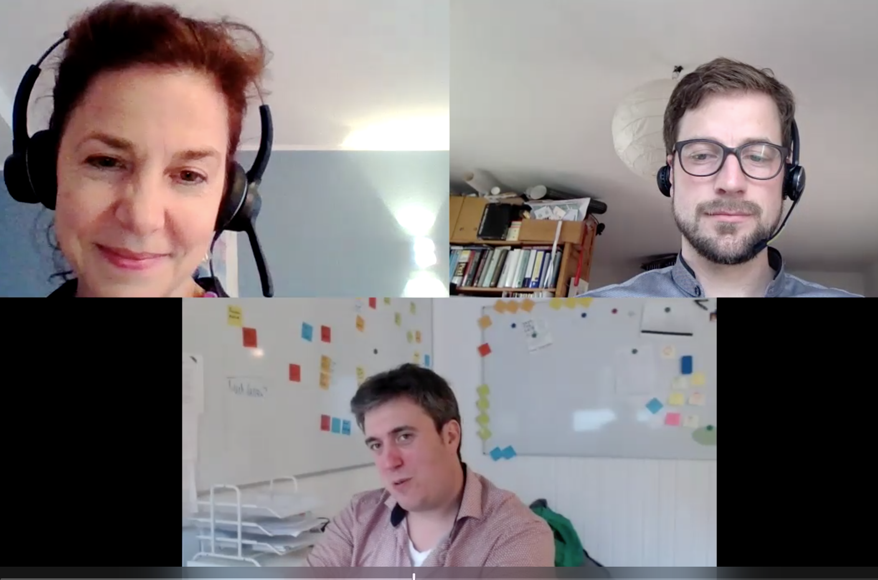
Challenge for our LLI project, “Remote Legal Teamwork“ in our interviews with legal professionals
meets
Design
Thinking!
“How might we
create better conditions for remote legal team work?“

Slide 3
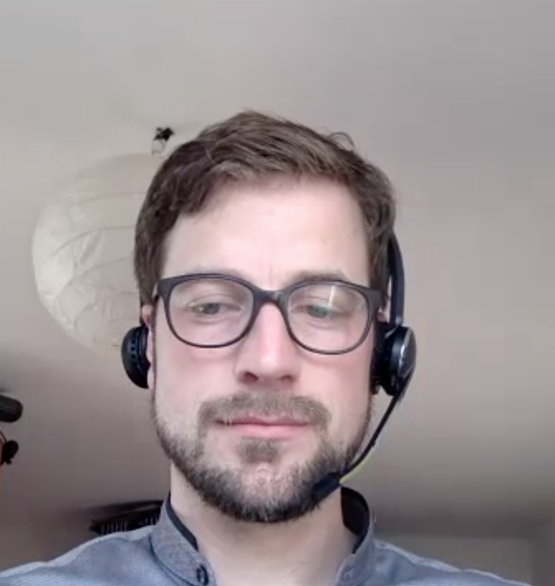
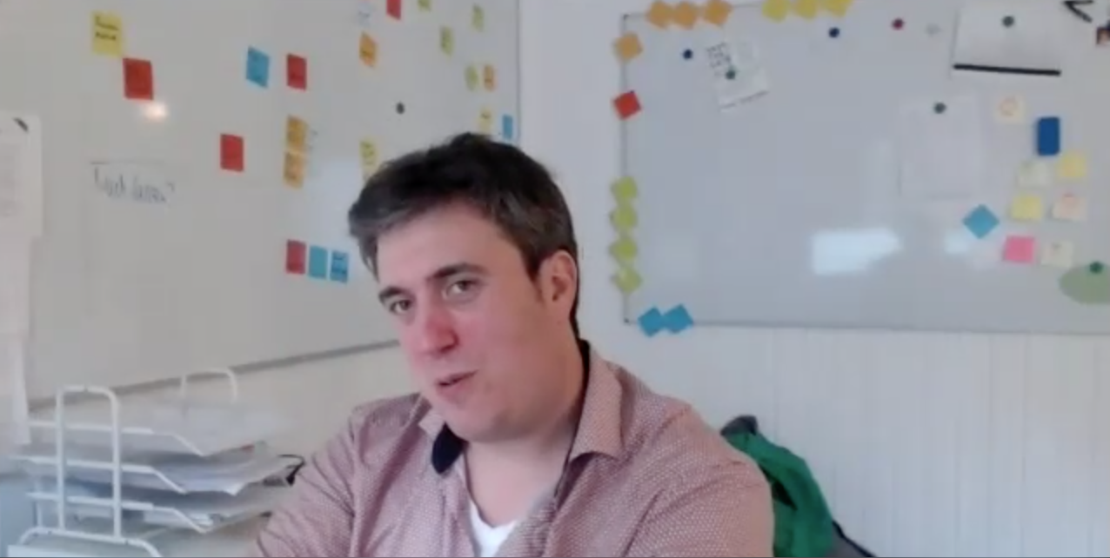

How to carry out a successful interview:
Leading to insights
Set the stage and establish housekeeping rules
Use empathy and listen more than you talk
Ask open-ended questions about the interviewees experiences
Use “why” to dig deeper
Look out for pain points, needs and “gold nuggets”
Take notes and use to find insights
Notes:
https://unsplash.com/photos/rRWiVQzLm7k

Slide 4
How might we make remote legal team work more fun?
We‘ll model the interview process with this Challenge question:
Notes:
Model the interview
https://unsplash.com/photos/rRWiVQzLm7k

Slide 5

A few points to remember when carrying out an user interview.
Very short teaser:
Leading to insights -
Use empathy and listen more than you talk
Ask friendly, open-ended questions about about our challenge question
Use “why” to dig deeper
Show appreciation for the interviewees' time and openness
?
HOW MIGHT WE MAKE REMOTE LEGAL WORK MORE FUN?
Notes:
https://unsplash.com/photos/rRWiVQzLm7k

Slide 6
What did we learn with our user research so far? Lots!
Take-Away Examples
Be deliberate about team building.
Try check-in protocols. They grab the feeling/emotion of the participant.
People can for example show if they are, tired, sad, glad, or stressed
Use pictures; e.g. my traffic light today is “red or yellow, or green”.
Pick an emoticon that describes how you're feeing.
Share the story of your name.
Finish the sentence: “When I dance I look like...“.
And don't forget: Turn on your camera!

Slide 7
Thank you for your active participation!
We cordially invite you to:
Dive into our essay: https://liquid-legal-institute.com/workinggroups/remote-legal-teams/
Contact Karla & Baltasar to participate in the research project: RemoteLegalTeams@liquid-legal-institute.org
More links and tips on our GitHub list!

Slide 8
Q + A's
Time for short questions?
Meets Design Thinking!
Notes:
Slide during the start of the session, while Astrid presents it

Slide 9
(That‘s it for now regarding User Research)
(to be continued another time…)
Meets Design Thinking!
Notes:
Slide during the start of the session, while Astrid presents it

